Slide 1
Test Lab Final Project SPRING 2022 CAR RACE GAME

Slide 2
Under the supervision of
Eng. Ahmed Bakr & Eng. Mahmoud Nawar
Arsanios Isaac Helmy
Mark Magdy Amin
Mina Nagy Latif
Youssef Nazeer Tawfik
Clara Raef Nasry
By

Slide 3
ABOUT THE PROJECT
This is a Car Race game played by a single player using Keil, C programming language and implemented on hardware components (most importantly TivaC kit & Nokia 5110 ADC).
The player moves in a direction where it is opposed by enemy cars. The player car should avoid hitting any of them.
There are 3 lives granted to the player, should the car hit any of the opponent cars the player loses 1 life out of the 3. After 3 hits, the LCD screens "Game Over" along with the final score.
The player car's position is controlled through the ADC slider.

Slide 4

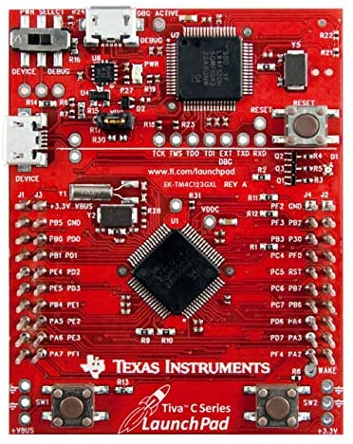
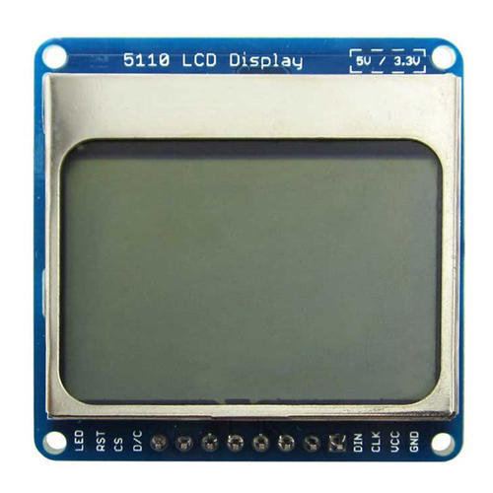
Tools
[Keil µVision IDE]
[Tiva™ C Series TM4C123G LaunchPad Evaluation Board]
[C Programming Language]
Hardware Components:
Nokia 5110 Blue LCD
TivaC Microcontroller kit
Bread board
Jumper wires, resistors & LEDs

Slide 5
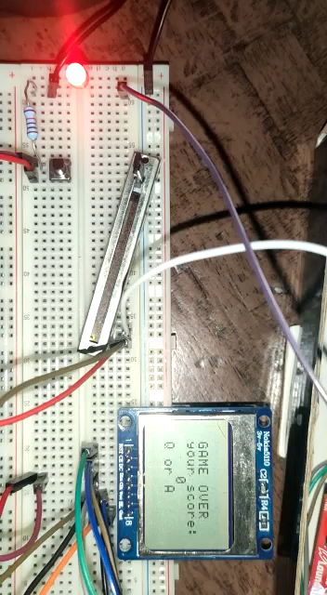
Latest Demo

Slide 6
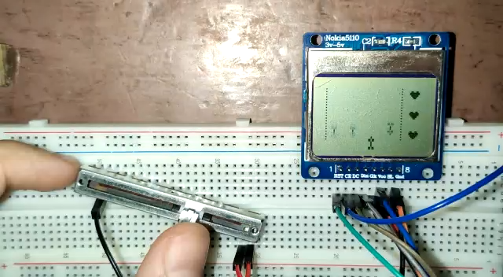
Older demo

Slide 7
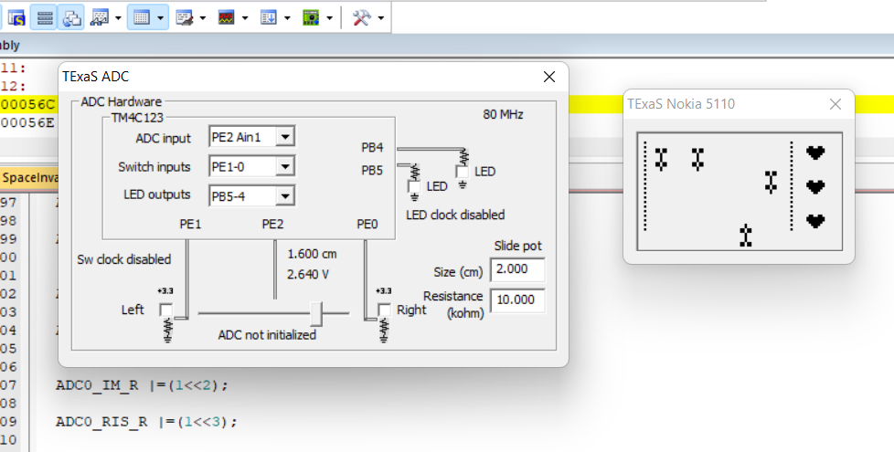
Debug Mode Screenshot Samples

Slide 8
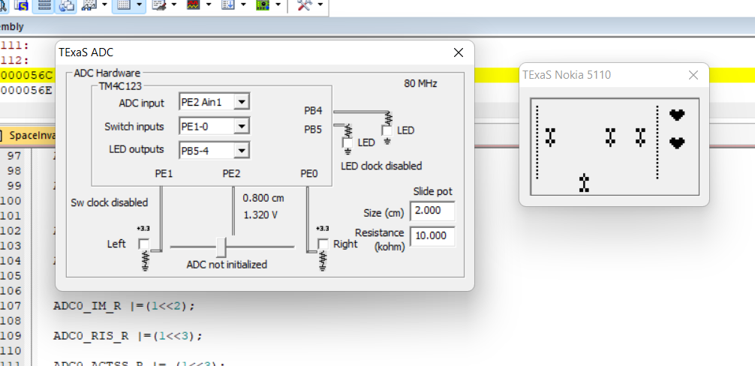

Slide 9


Slide 10
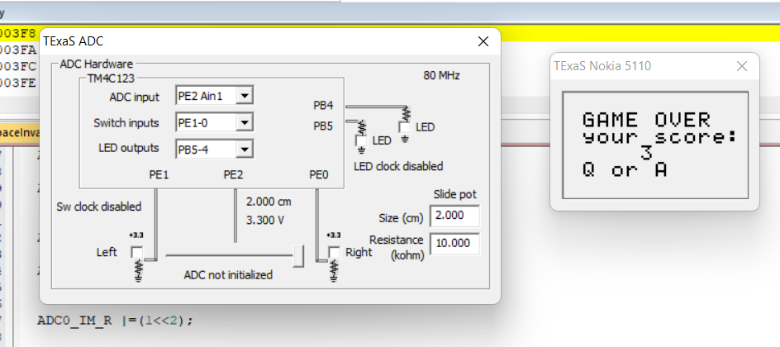

Slide 11
RESOURCES
[Keil Product Manuals]
(https://www.keil.com/support/man/docs/uv4/)
[Tiva™ TM4C123GH6PM Microcontroller DATA SHEET]
(chrome-extension://efaidnbmnnnibpcajpcglclefindmkaj/https://www.ti.com/lit/ds/spms376e/spms376e.pdf?ts=1652959781573)
[A playlist of our weekly lab tutorial videos]
(https://www.youtube.com/playlist?list=PL8QIIvvGlfWB-Q_3aRYP_fuhROhXuZ6Ck)

Slide 12
THANKS!

